Slide 1

Fault Detection in Multilevel H-bridge Inverter using Machine Learning Algorithm
PSG Institute of Technology and Applied Research
Department of Electrical and Electronics Engineering
Presented by
BAASKAR R ( 715519105301)
GOWTHAMAN K ( 715519105302)
NICK SALTER S ( 715519105307)
SANJAY S ( 715519105311)
Guided by
Dr. SATHYANATHAN M

Slide 2
PSG Institute of Technology and Applied Research
Department of Electrical and Electronics Engineering
Area of study
Fault Detection in Power Converter Circuits
The research problem that motivates the project
Multilevel inverters are used in many applications such as Static VAR compensation, Variable speed motor drives, High voltage system interconnections, High voltage DC and AC transmission lines, Electric vehicles, etc.
It is more difficult to detect the fault in hardware if any of the circuit components fails.
This project focuses on open- circuit fault of the switches in the multilevel inverter.
The faults will be identified using suitable machine learning algorithm.

Slide 3
PSG Institute of Technology and Applied Research
Department of Electrical and Electronics Engineering
Objectives of the Project
To develop a machine learning algorithm to detect the open switch faults
To construct a 5-level H-bridge inverter circuit and verify for a standard output
To find the faulted switch.
To compare the results for various fault cases.

Slide 4
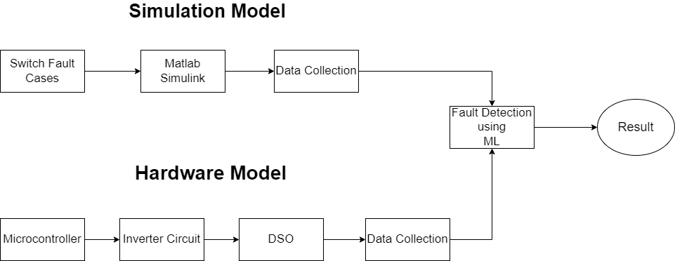
PSG Institute of Technology and Applied Research
Department of Electrical and Electronics Engineering
Methodology

Slide 5
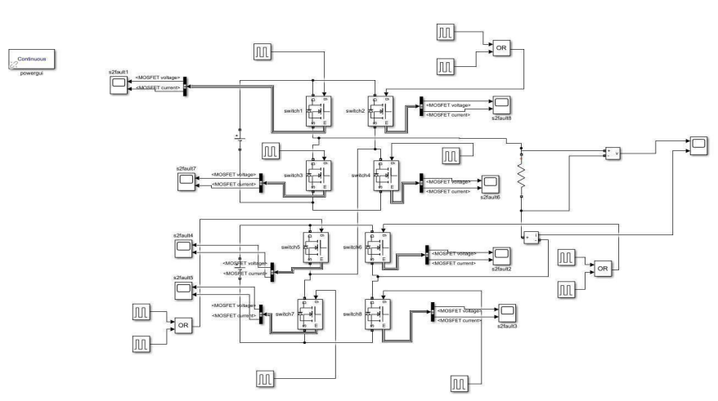
Simulation Model
PSG Institute of Technology and Applied Research
Department of Electrical and Electronics Engineering

Slide 6
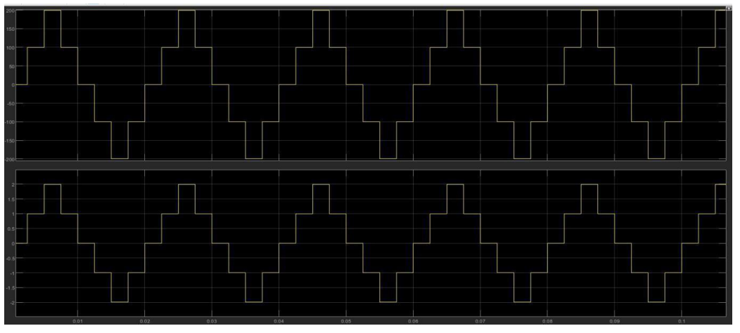
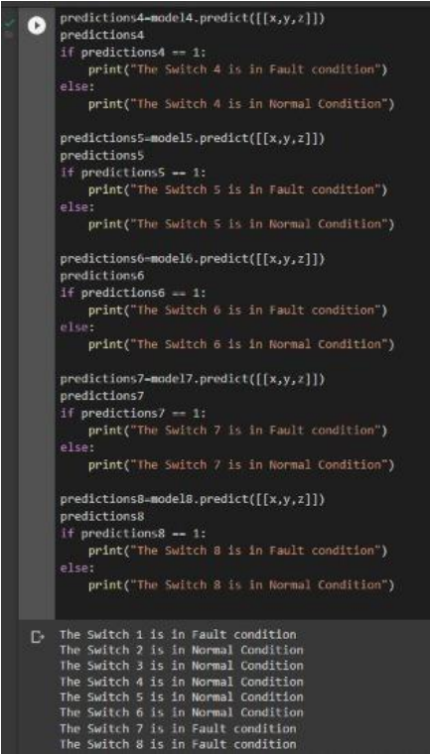
Simulation Output
PSG Institute of Technology and Applied Research
Department of Electrical and Electronics Engineering

Slide 7
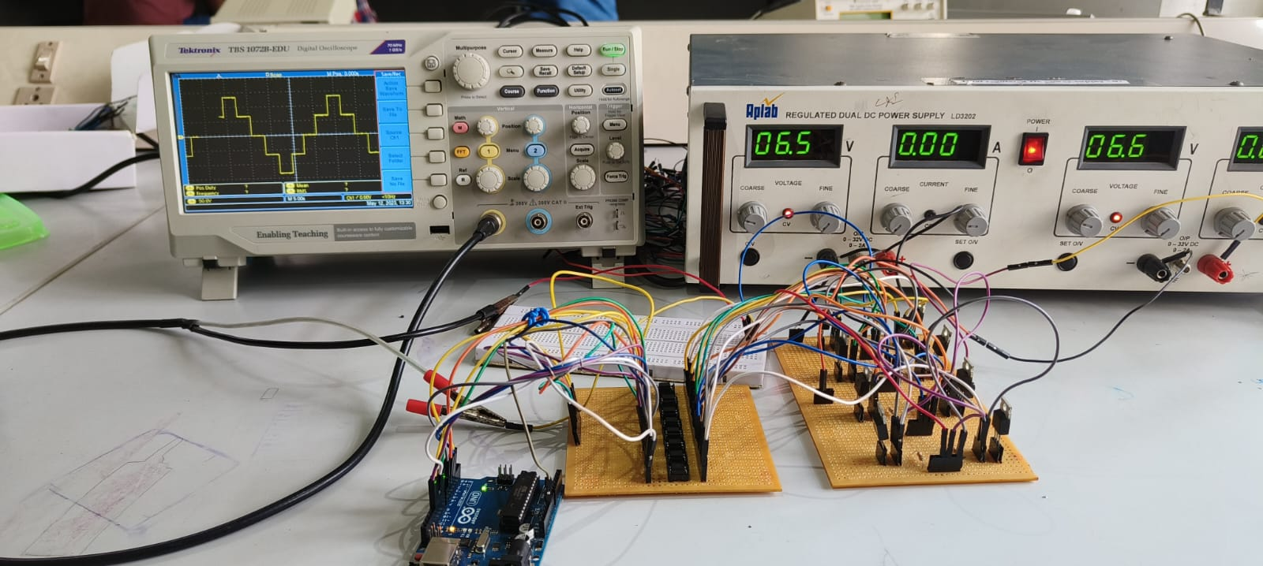
Hardware Model
PSG Institute of Technology and Applied Research
Department of Electrical and Electronics Engineering

Slide 8
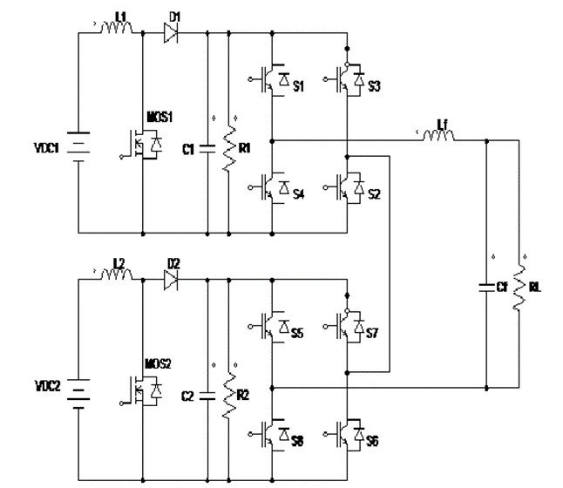
Cascaded H-Bridge

Slide 9
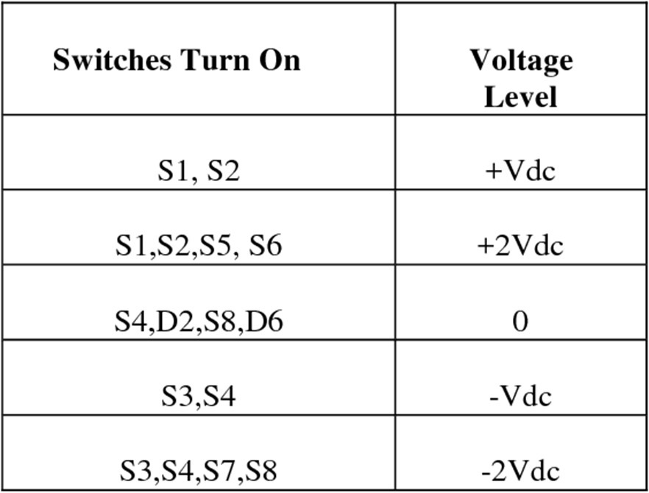
Different Voltage Level Of Cascaded H-Bridge
PSG Institute of Technology and Applied Research
Department of Electrical and Electronics Engineering

Slide 10

PSG Institute of Technology and Applied Research
Department of Electrical and Electronics Engineering

Slide 11
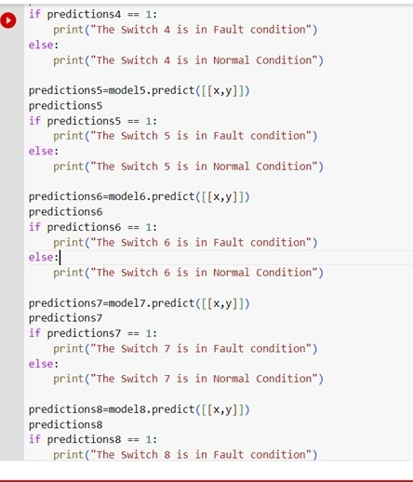
PSG Institute of Technology and Applied Research
Department of Electrical and Electronics Engineering
OUTPUT:

Slide 12


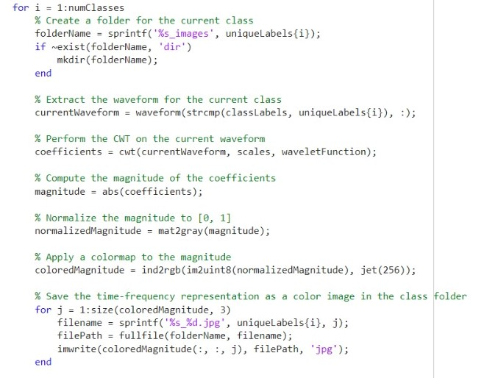
Future Works:

